Slide 1
Mobile Apps
Pravin Y Pawar

Slide 2
Mobile device website traffic
Increasing!
Now mobile causes half of worldwide web traffic!
Continuously hovering over 50% for last years!
Causes
acceleration to digital initiatives
moving to digital models of business exclusively
the rollout of 4G, plans for 5G
increasing IoT devices
Lot of mobile only population in developing countries

Slide 3
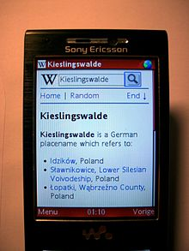
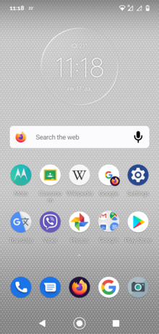
Mobile Apps vs Mobile Websites
No doubt businesses can ignore Mobiles!
Which way to go ?
Mobile websites
Mobile Apps
Looks similar but are different mediums!
Depends also upon
Target audience and intent
Budget
Image source : Wikipedia

Slide 4
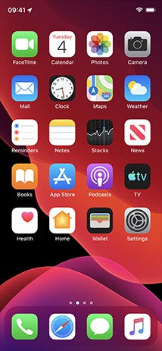

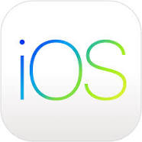
Mobile Apps
Aka Native Apps
Are meant for specific platforms
Apple iOS
Google Android
Needs to be downloaded and installed on mobile devices
Advantages
Offers a faster and more responsive experience
More Interactive Ways For The User To Engage
Ability To Work Offline
Leverage Device Capabilities
Source : Wikipedia

Slide 5
Mobile Websites
Aka Responsive mobile websites
Websites that can accommodate different screen sizes
Customized version of a regular website that is used correctly for mobile
Accessed through Mobile browsers
Advantages
Available For All Users
Users Don’t Have To Update
Cost-Effective

Slide 6
Thank You!
In our next session:

